Slide 1
dismantling
the master’s infrastuctures
Notes:
Today we talked about platforms, but I will argue that it is actually infrastructure that produces these platforms, not just makes them possible.
The extractive practices of the platforms is a consequence of the structure of the infrastructure and continues to drive the development of the infrastructure in a particular direction.
Platforms are the fruits from the tree of infrastructure - but also the infrastructure in itself itself an explification of power relation
A power relation that is shaped in a tug along two axis: between states and corporations and intelligence in the network or at the edges

Slide 2
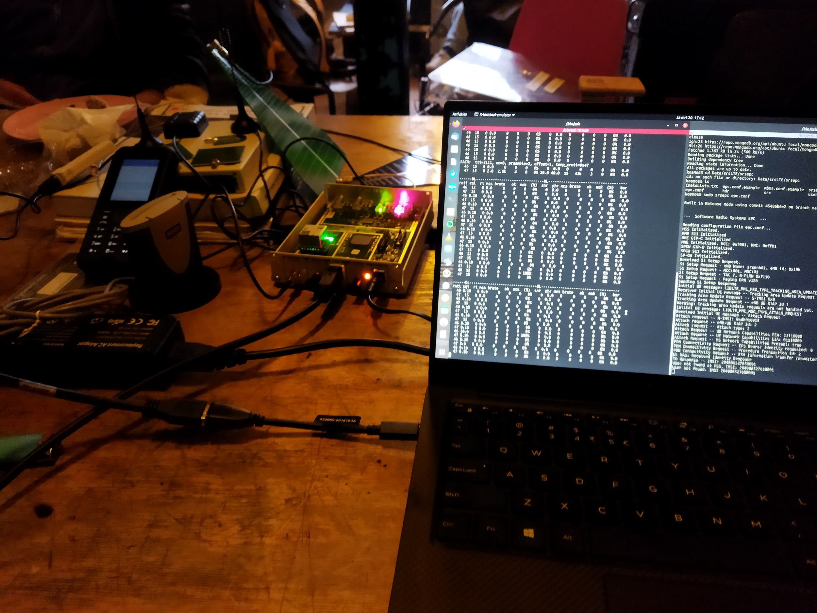
Niels ten Oever, PhD
Postdoctoral Researcher
University of Amsterdam
IN-SIGHT.it
mail@nielstenoever.net
https://nielstenoever.net
@nielstenoever
Notes:
Hi, am Niels
I work at the University of Amsterdam.
Previously I studies the inscribing, resistance, and subversion of norms in the Internet infrastructure and architcture in the IETF, ICANN, RIPE, IEEE, which led to my PhD dissertation Wired Norms.
Now I am more focused on the standardization of 5G in the 3GPP and building of experimental 5G networks with the IN-SIGHT.it project
Interested in power and global communications networks.

Slide 3
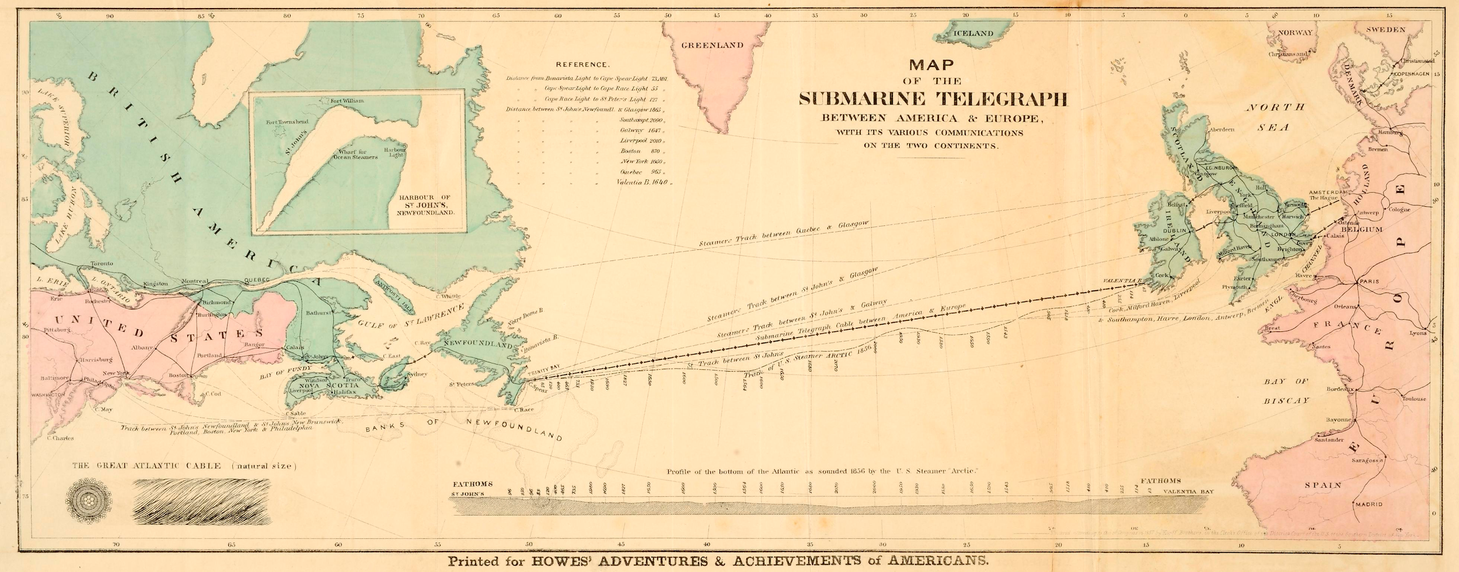
Notes:
First intercontinental comms network was a transatlantic cable thas was laid in 1865. Worked on for three years, worked for three weeks.
History of communications and standardization is a history of failure and much as it is of success
At the beginning of the 20th century the Prince of Prussia wanted to communicate with US President from his ship, but could not due to diff int standards

Slide 4
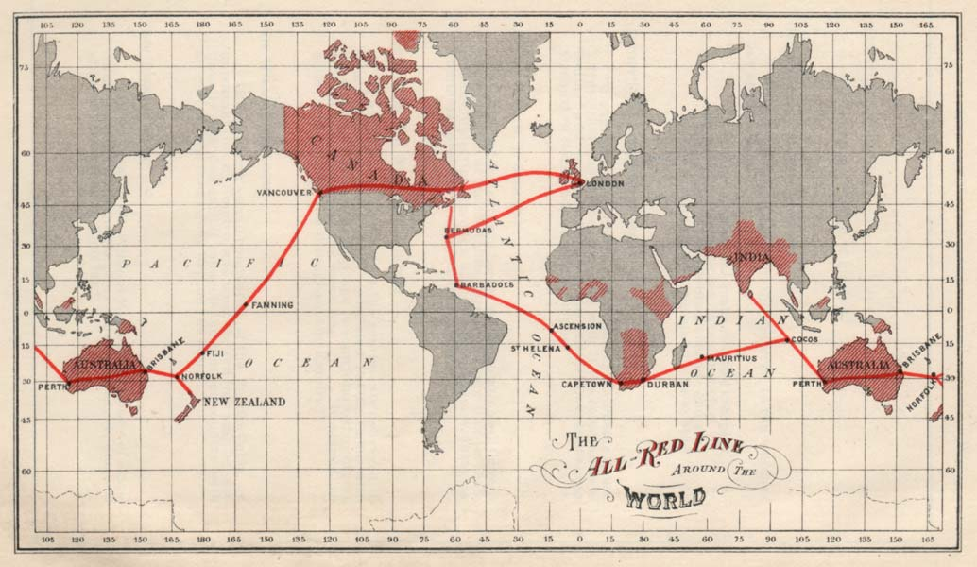
Notes:
Communications networks are always are proxy for power and intrinsically linked with militarism and colonialism
Telegraph changed colonialism to imperialism by establishing centers of power
The location of the center and locus of power and the removal of friction is a returning concept in communication networks
It determines the ability of decisionmakers to exert power of a topological empire, that topographically might be hard to even imagine

Slide 5
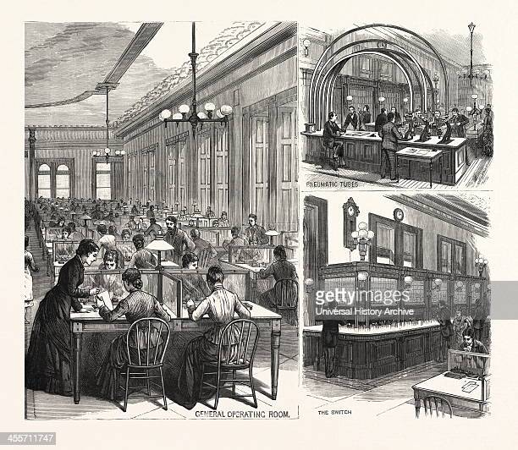
Notes:
History of global communication networks is also a forgotten history
Of women operators, female programmers, and maintainers and institutions that make infrastructure work
Infrastructure is inherently relational: standards and people are as much part of it as the fysical infrastructure
Infrastructure also tends to hide itself: we take it for granted and it only shows itself to us when it does not do what we expect it to do
But at the same time it shapes our reality and self the rules for our every day life

Slide 6

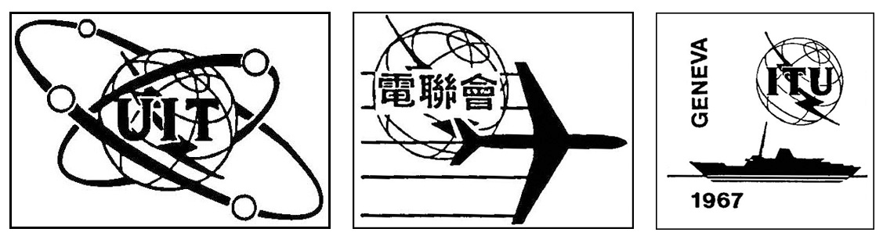



Notes:
The story of telecommunications is also bound in institutions. To ensure that the debacle of 1865 and disfunctional cable was not to be repeated, the International Telegraph Union was established.
Oldest still functioning global governance body
Since 1947 part of the United Nations - governened all comms networks: telegraph, telegram, telephone, radio, TV, spectrum
until…….

Slide 7
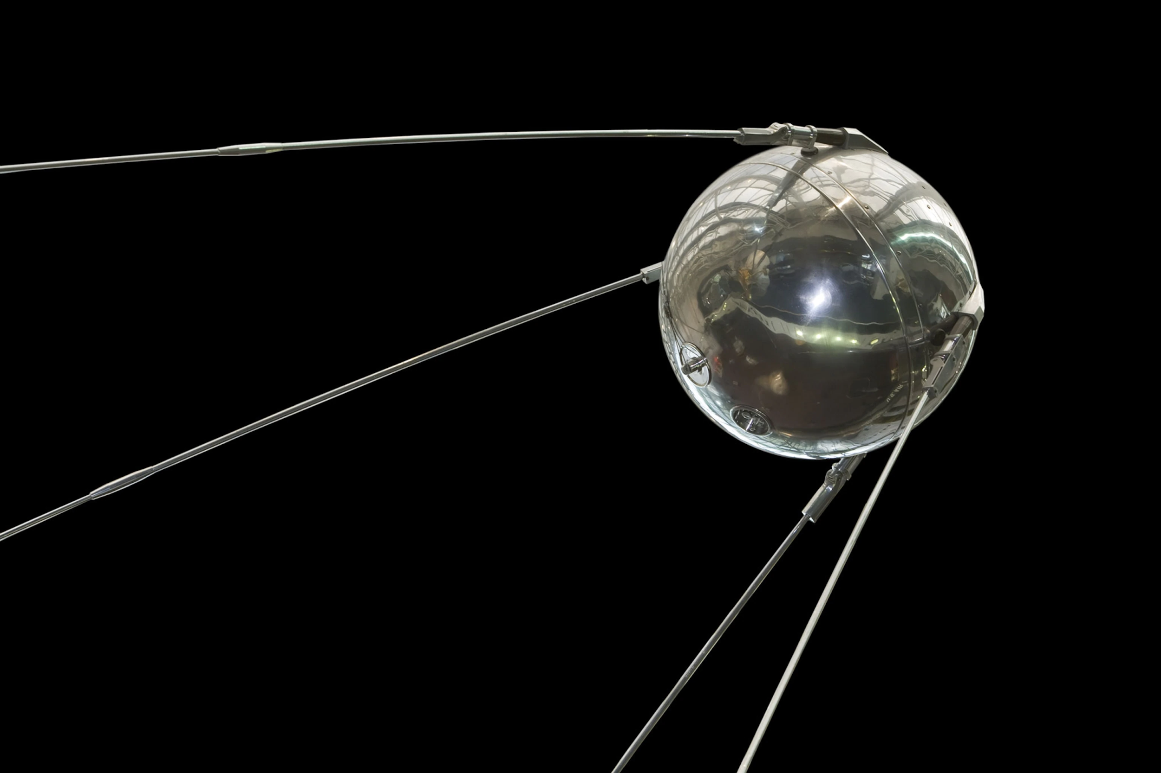
Notes:
October 1957
Societ Union launched artificial satellite
TIME magazine: those chilling beeps
Americans were terrified
Established Advanced Research Projects Agency
The instutute that would fund and develop the technology and networks that would evolve into the Internet
Distributed network so it could withstand a nuclear attack

Slide 8
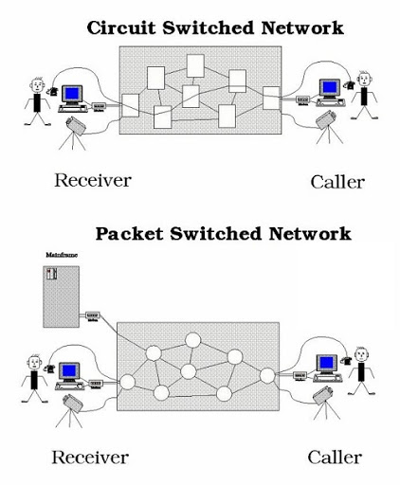
Notes:
Previous networks were circuit switched - needing continuous connection. Imagine a continuous flow. Very stable, but deal badly with interruptions
ARPAnet, as design criterium, needed to be able to withstand nuclear strike. Therefore distributed and decentralized. Made use of packet switching.
Packets, little trucks, traveling through the network. They get lost and retransmit. Loss is not acceptable in telco netowrks and pretty much stanard practice in the Internet.

Slide 9
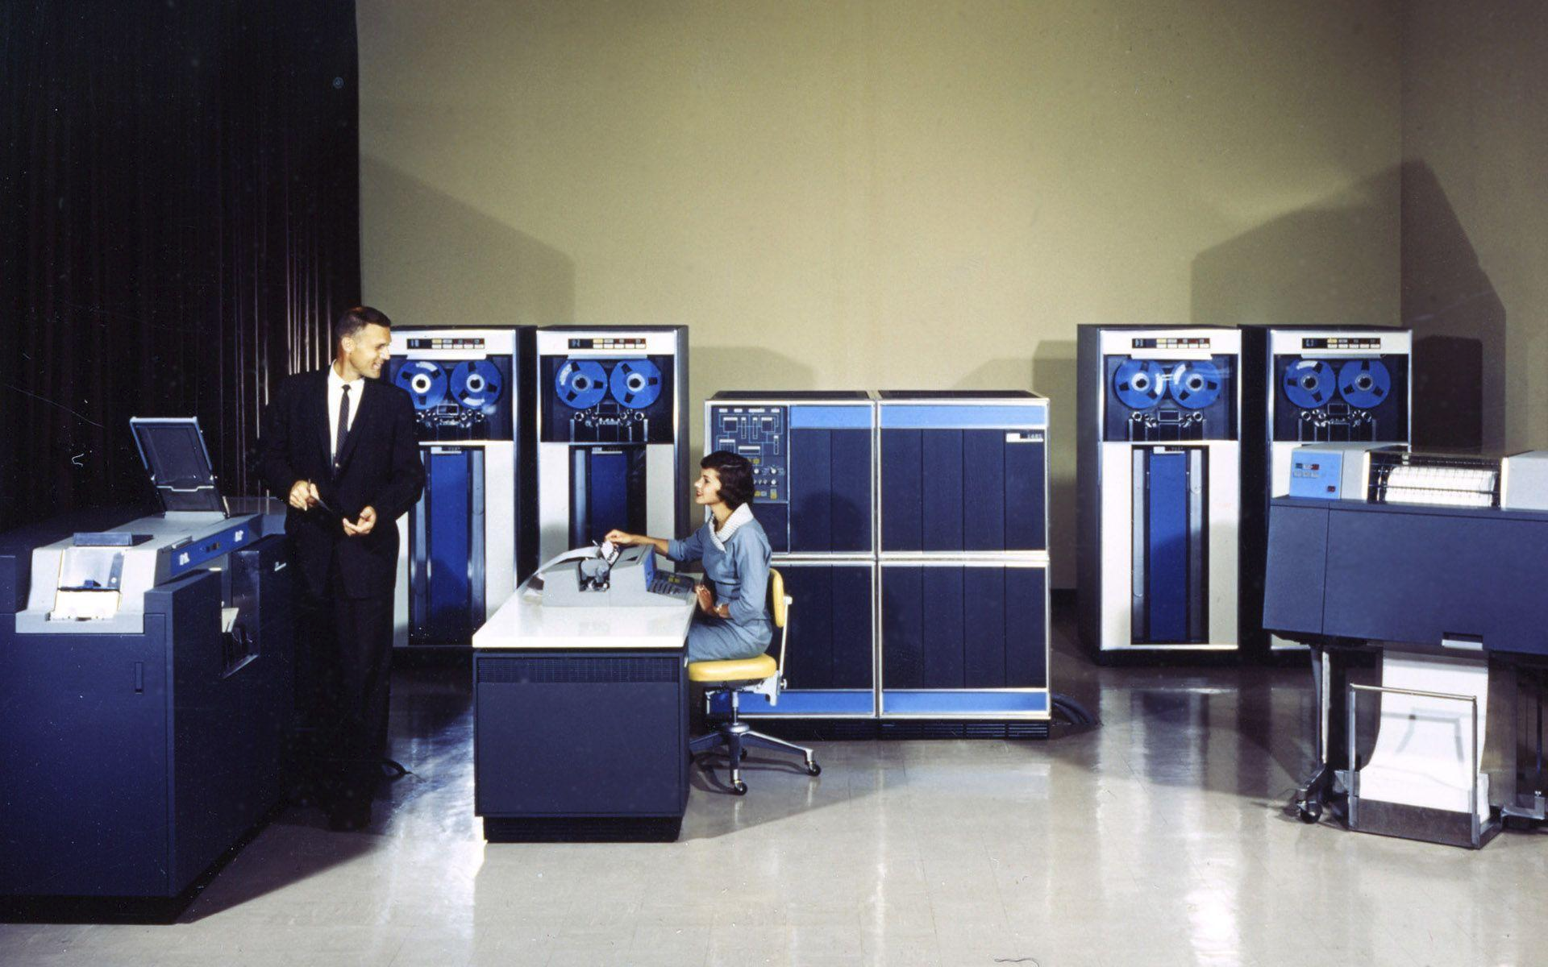
Notes:
In circuit switching: the network is SMART and the endpoints are dumb (think of touch dial phones)
In packet swithcing: the end-poiints are SMART and the network is DUMB.
Network only exists to transport packets, not to translate, hand over, or control.
In telco networks, the networks were the locus of power. Owned by and standardized by states (Europe and colonial powers) or monopolies (US: Western Union)
In packet switched networks, the end-points were the locus of power.

Slide 10
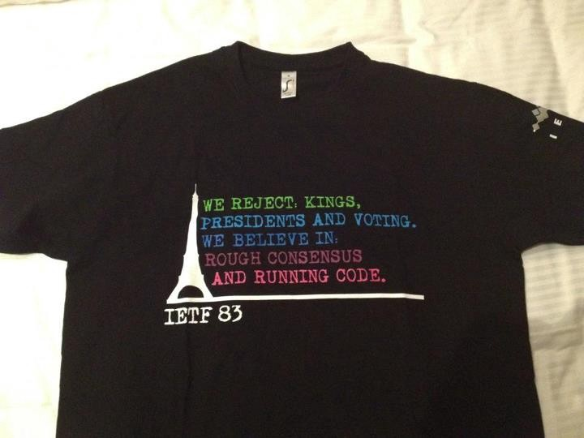
Notes:
This brought about a shift where not just government had a vote, but new standardization bodies, such a the Internet Engineering Taskforce too, which led to the statement that….
The Internet and its institutions brough about a sense that the power of the nation state was waning
Also fitted with the 90s Washington Consensus and The End of History
The Soviet Union, the maker of Sputnik, was beaten by the US and the Internet
The Internet would bring freedom from tyranny by nation states
Some scholars already then argued this would just replace US military with US corporate power.
We are now at the end of that era

Slide 11
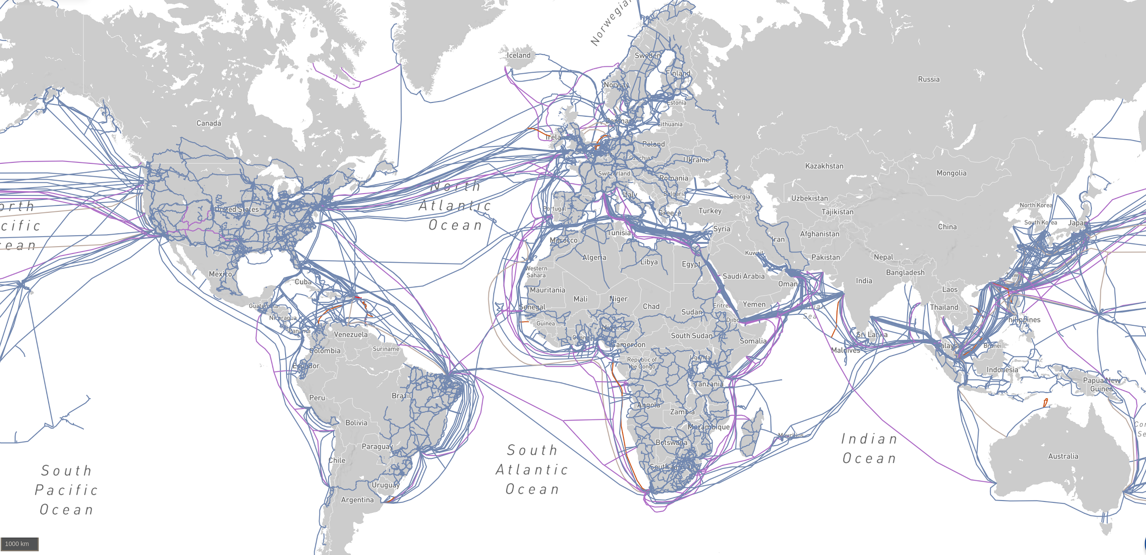
Notes:
Submarine cables are no not just between Europe and the US, but connect the whole world

Slide 12
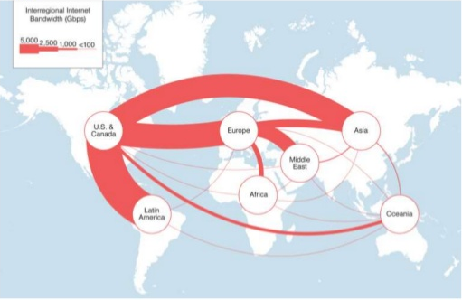
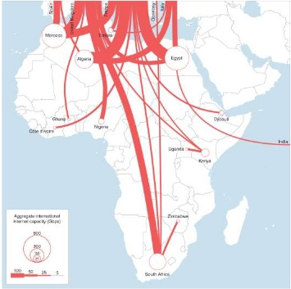
Notes:
But when one looks at the shape of data streams, on sees something very different
Reliance of the world on US data centers
Almost total reliance of Africa on Europe
Repeating and reinforcing extractive structures

Slide 13
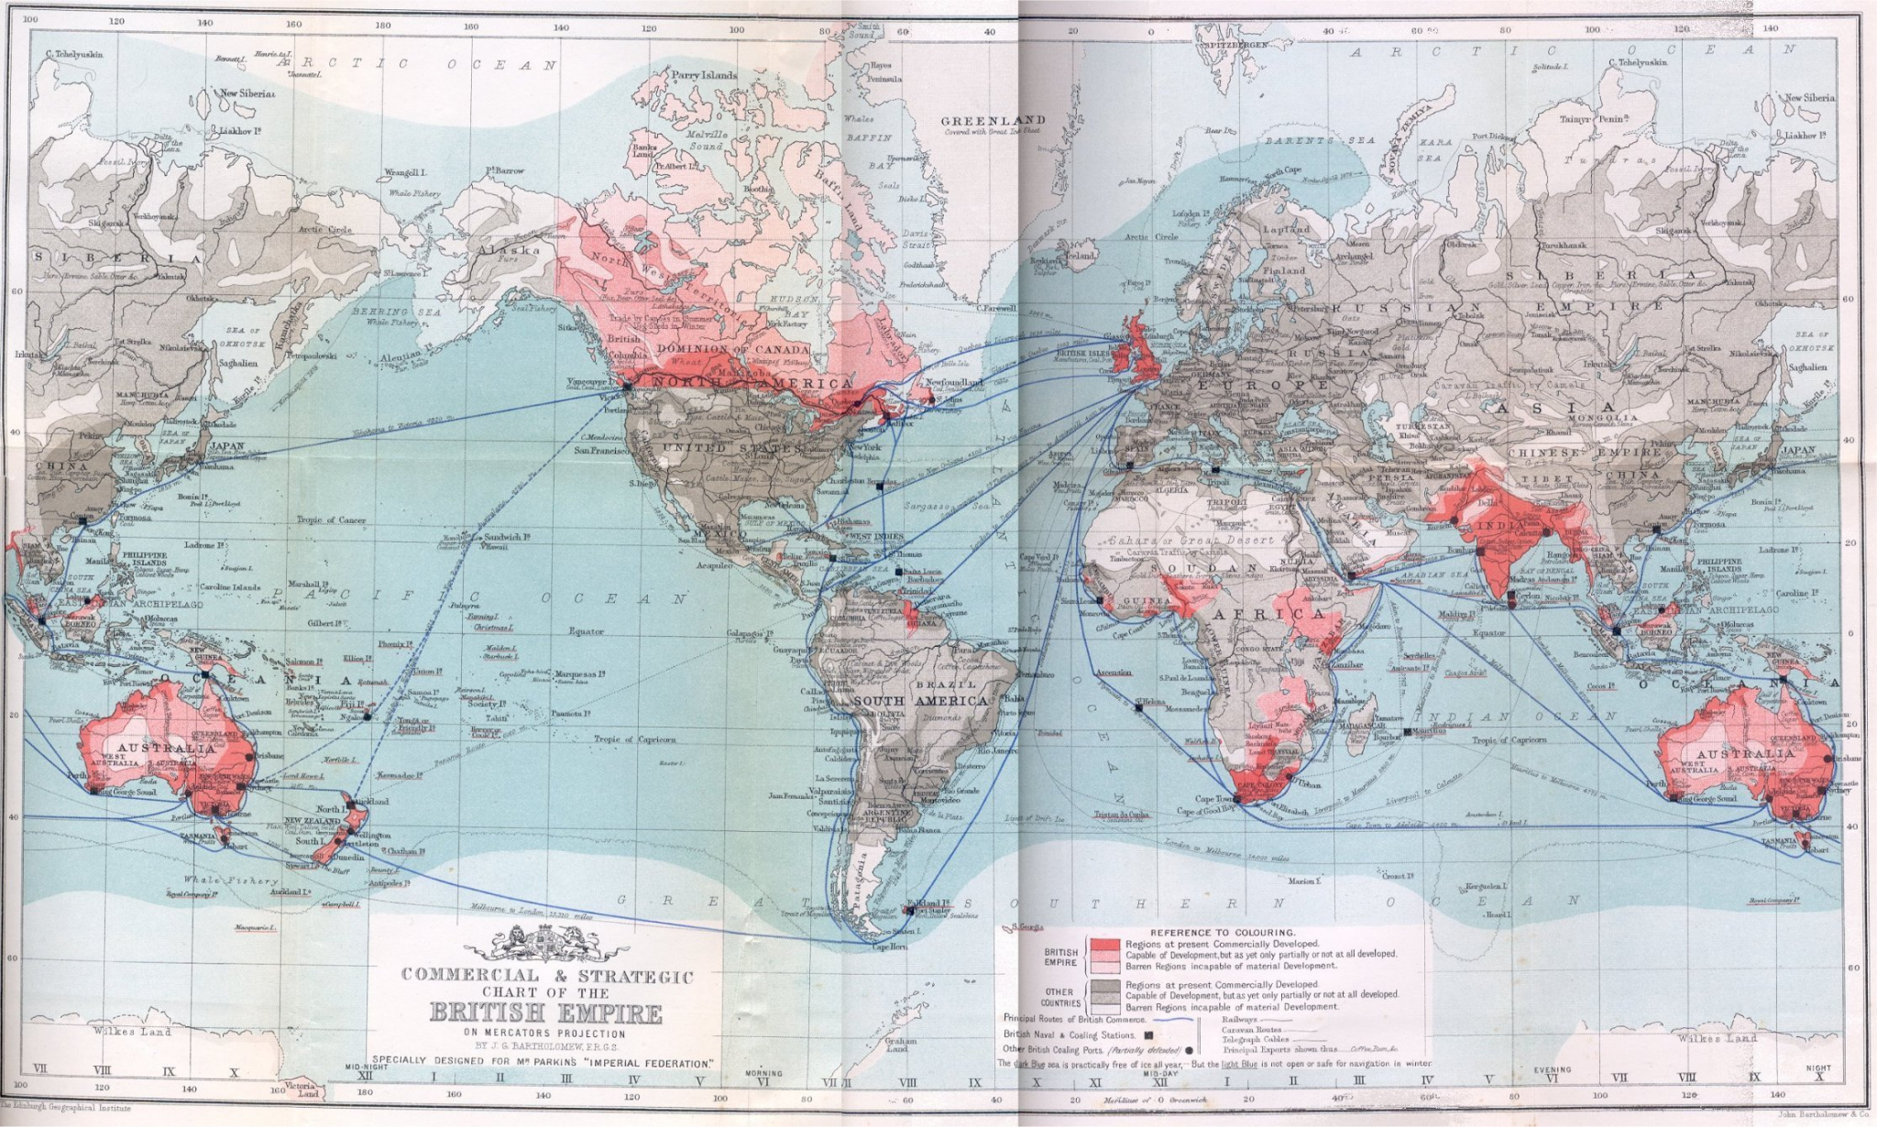
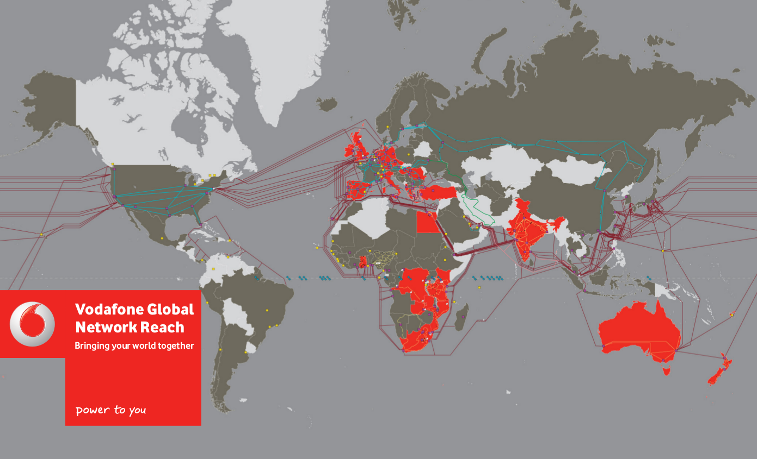
Notes:
Where topographical analysis show a stability over a long duree, toplogical reconfigurations might give space ofr interpretations.

Slide 14
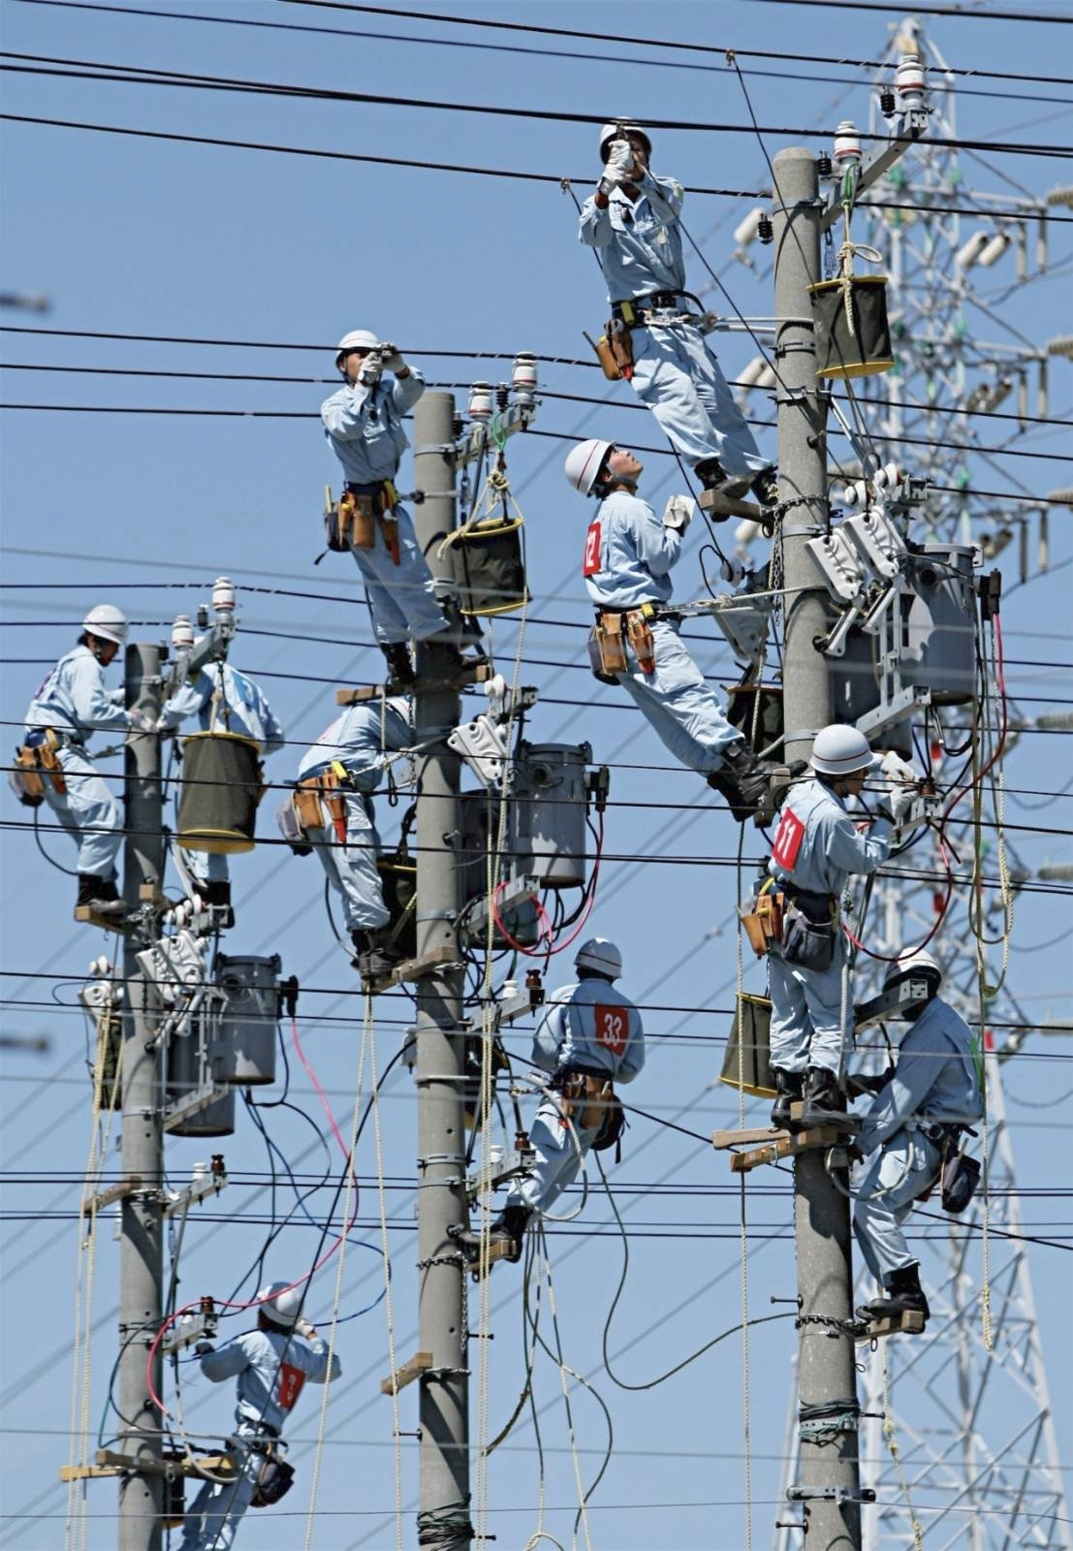
Notes:
This spurred the development of new technologies in rising world powers, such as China and Korea.
Years they were told they should stop copying and develop their own patent portfolios
Now they did...

Slide 15
}
Application
API’s (for instance for social media networks), HTML, CSS →W3C
}
Presentation
Session
HTTP, QUIC, TLS, TCP, DNS, BGP → IETF
Transport
}
Network
}
Data Link
WiFi, ethernet → IEEE
2G, 3G, 4G
→ 3GPP
Physical
Notes:
The standardization of the protocols and languages of these different layers happens in different institutions - the are institutions of telecommunication governance.
The World Wide Web Consortium, or W3C, governs the upper layers also known as the web, the Internet Engineering Taskforce most of the internet layers, the Institute for Electrical and Electronic Engineers sets standards for the physical layers and the 3GPP, an umbrella organization for national and regional telecom regulators and operators, set the standards for telecommunication access.
This is the sediment of a tussle over control between these actors, that all have particular dominant stakeholders with distinct interests. The IETF is the dominant body that sets the protocols for the Internet - but this might actually change.

Slide 16
}
}
Application
API’s (for instance for social media networks), HTML, CSS →W3C
}
Presentation
Session
HTTP, QUIC, TLS, TCP, DNS, BGP → IETF
Transport
}
5G in 3GPP
Network
}
Data Link
WiFi, ethernet → IEEE
2G, 3G, 4G
→ 3GPP
Physical
Notes:
Except for dominating the 3GPP, they also expanded the functionalities of the 5G network to also include functionality that would have normally been set on other layers of the protocol stack.

Slide 17
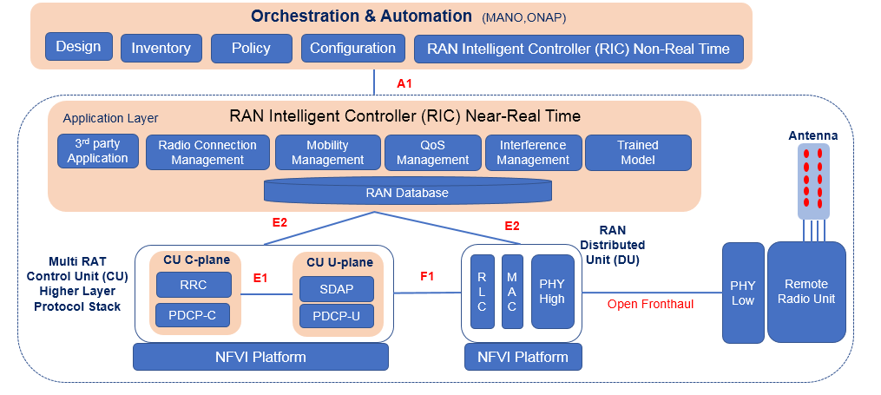
Notes:
in 5G network become intelligent again - through the leveraging of concepts such as software defined network, network function virtualization, information centric networking, and edge computing.
This is possible through the roll-out of many new devices that are not dependent on implementation in hardware through logic gates such a previous network, but due to the increase in processor speeds and lowering of costs of memory, can all be implemted in software on more general purpose computing devices. This makes the whole network a software data plane.
The network becomes more configurable and less transparent.
Furthermore, it is connecting to more devices that function more as sensors than as computers
Computing increasingly happens in data centers and in the network itself - not on dedicated devices
This makes the network omnipresent and opaque at the same time
With WiFi you can choose which devices you connect to your router, but with embedded sims (esims), many devices will be connected BY DEFAULT
This means it will be nearly impossible to know which devices in your house are connected to the network

Slide 18
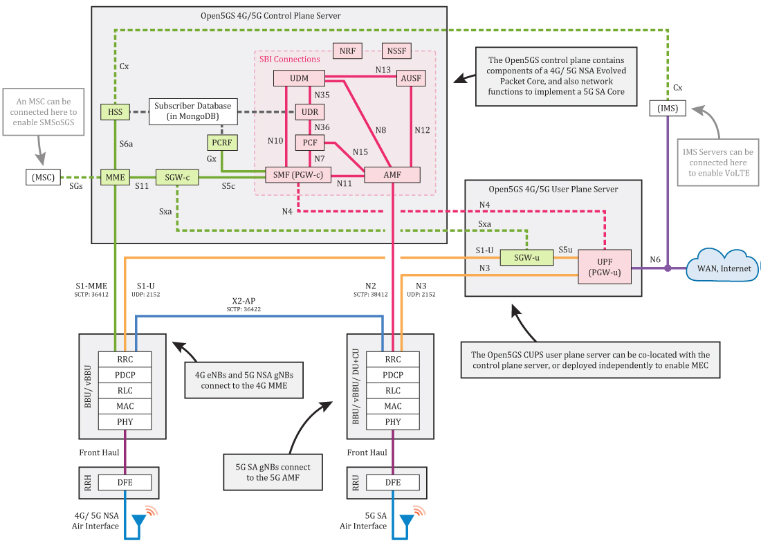
Notes:
5G network consist of many microservices that can route your traffic, but also actually do computation in the network that goes far beyond caching and streaming.
This means aside from it becoming hard to know which devices are connected, it will also become harder to know where and how the network is processing your data and requests.

Slide 19
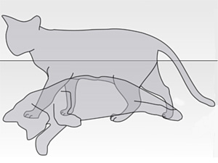
‘5G is not optimized for anything - it is optimized for everything’
‘Vendors, telecom operators, and ‘verticals’, all create opportunities for the real use case to emerge’
Notes:
5G can both connect you direct to another end node, or perform the functions of an end node directly from a device near your. And you would not know the difference.
When talking to a senior 5G standards engineer from a large multinational telecommunication operator, I asked him: what is 5G optimized for? He answered: see above
And here we see the quantum state of the 5G network: it is possible to be intelligent and dumb at the same time.

Slide 20
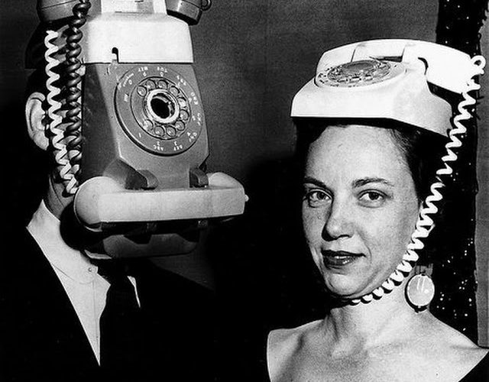
Notes:
Two contesting regimes: state aligned telcos vs the largely American Internet and platform industry
This is a very similar situation to the late 19th where in the US networks were dominated by an oligopoly of companies and in Europe by states
This is a continuous tug between states and private sector and intelligence in the network and intellegence in the endpoints
We now had a few decades of privately owned networks with intelligence in the end-points and are now moving to more intelligent network that are managed in alignment with the norms set by nation states

Slide 21
Axes of control
end-to-end
early internet
current internet
state
private sector
telegraph and telephone networks in Europe
telegraph and telephone networks in the US
in the network
Notes:
Early transnational communications networks in europe were owned and regulated by states, in the United States they were ran and owed by oligopolies dominated by Westen Union and the Bell Company. But these networks had their intelleigence and control in the network. The early internet was distributed, but controlled by the United Stated. The late Internet, after commercializationa nd privatization in the 90s, was controlled through oligopolies in the private sector

Slide 22
Axes of control
end-to-end
5G
early internet
current internet
state
private sector
telegraph and telephone networks in Europe
telegraph and telephone networks in the US
in the network
Notes:
In 5G, all positions are true at the same time. It is implemented through privatized telecommunications operators, but with access for ‘lawful intercept’ by states at every level of the stack. Furthermore, the services of 5G are so complex that many hgave been outsourced to third party companies. Endpoints can communicate directly, or communicate with the network. The architecture of 5G is the fog of cyberwar

Slide 23
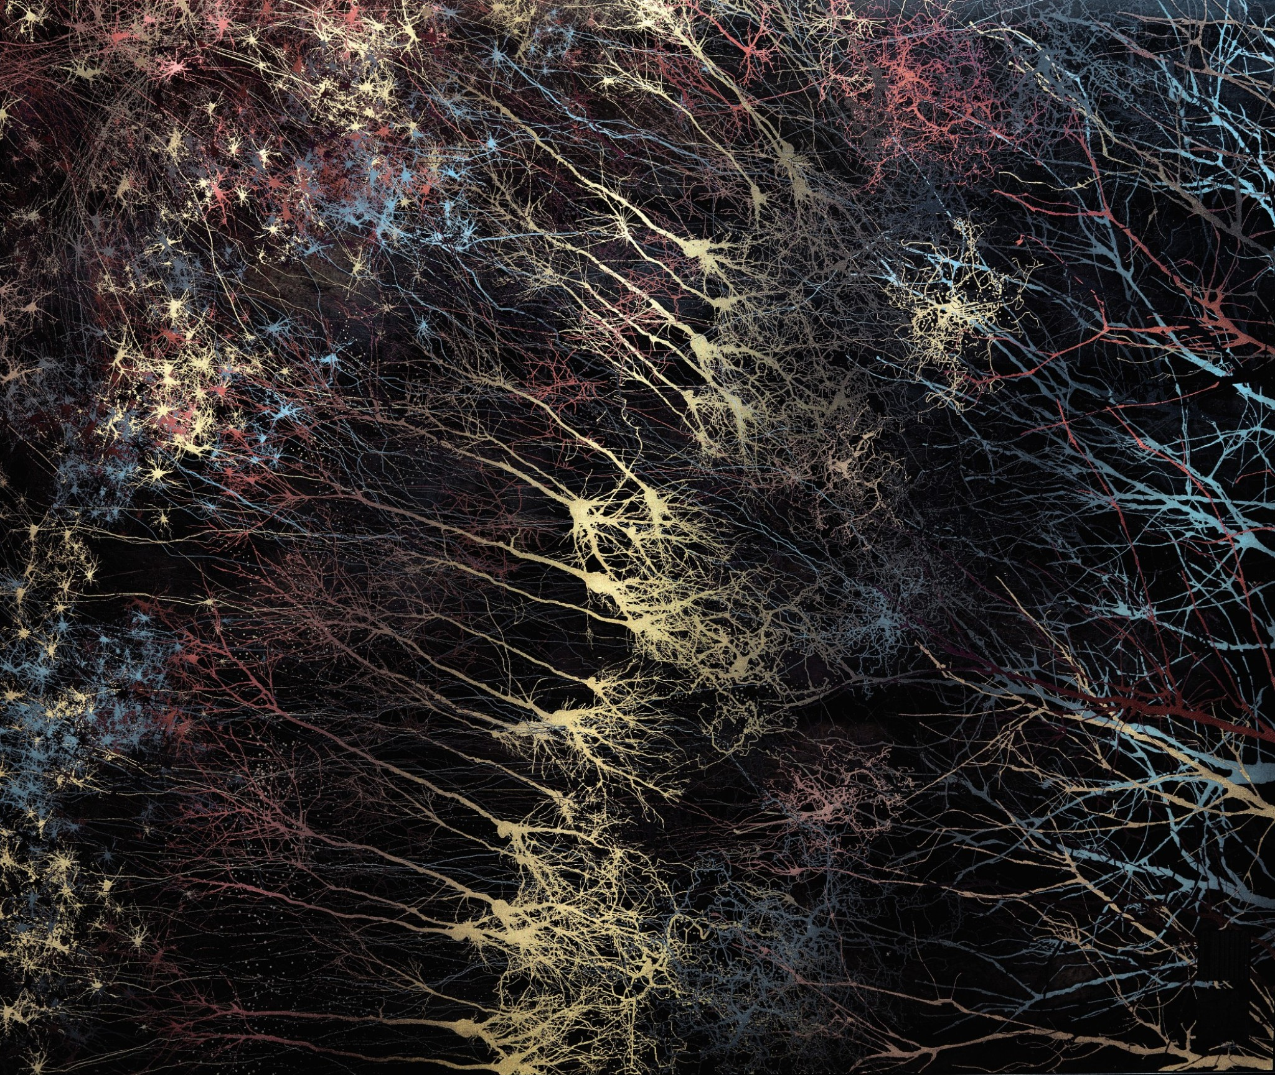

Notes:
What does this mean? That the problem is maybe not as technological as we might think - or at least need only technological. This means that solutions to the questions of power are ingrained in computing and networks, buit are not actualized by them. They cannot only be solved by changing the power imbalances that are reflected in technology.
The perspective of quantum social sciences affords us to overcome deterministic thinking about reliance on the state or private sector for control over transnational communication networks - without needing to overcome them perse.

Slide 24

Notes:
Technology should be a means of personal and societal reflection and emancipation
Technology and communication networks never exist by themselves
They represent societal powers and inequalities
Changes to networks and technologies therefore need to be grounded in intersectional analysis
This needs economics, law, sociology, art as well as engineering

Slide 25
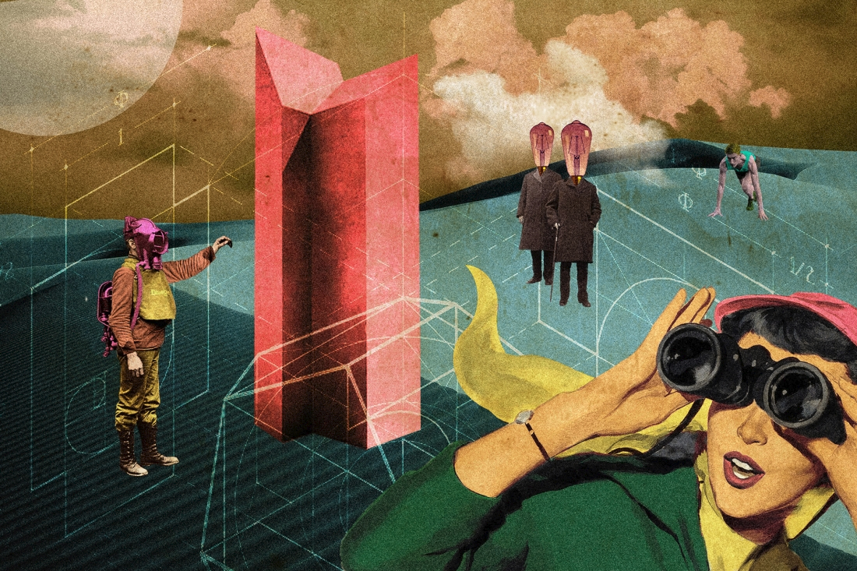
Notes:
This should be the basis for reinvisaging networks that produce a world we want
Not a world where the network is maximally optimized to serve you ads extract personal data to centralized servers
Because one thing we learned: technological distribution does not protect again economic or institutional centralization. Quite the opposite.

Slide 26
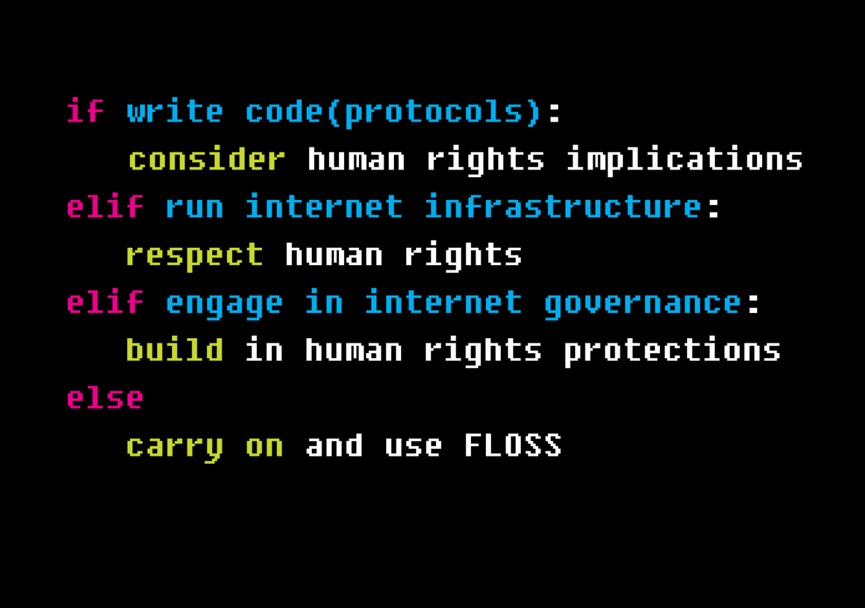
Notes:
If we want to limit the power of platforms - we need to reinvisage and rebuild the infrastructure, to build an Internet in the public interest
Not a machine for militarlization, no an apparatus for policing, an advertising device, nor an architecture of control.
But we cannot wish power away - this means it needs to be built with accountable institutions and technologies as an inherent part of the infrastructure.

